Slide 1

Baruch Data Science Challenge 2021

Slide 2

Meet your Team
David Messineo Manager US Data Science Team LinkedIn: davidmessineo
Christian Bernards Data Science Lead US Data Science Team LinkedIn: christianbernards
Pretish Kuruvila Data Scientist US Data Science Team LinkedIn: pretish-kuruvila

Slide 3
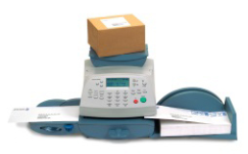
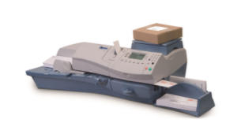
Background
Pitney Bowes is one of the leaders in the Mailing meters space
Mailing meters allow businesses to be more productive by simplifying their mailing and shipping
We offer leased hardware, as-well as SaaS solutions
Our clients must be able to rely on our meters to function to meet their customers’ needs

Slide 4
Problem Statement
Pitney Bowes uses predictive maintenance to reduce the risk of down-times of meters deployed at our clients’ offices
Since our meters are part of our clients’ business operations, we must be proactive about identifying potential problems early on to avoid any sort of disruption for our clients
Predictive maintenance allows us to have the required replacement parts where they are needed, and to proactively schedule an appointment with our customers if needed
The meters are Cloud-connected, which allows us to monitor the health of a device and detect potential problems early on
For this challenge, we generated a training sample for ~40k meters. You are asked to build a model that can predict which meters will fail within the next 7 days.

Slide 5
Solution Requirements
The following files are provided for you to use:
train.csv – Sample data for meters with a flag whether they fail within the next 7 days
test.csv – Sample data without fail flag. Your prediction for these meters is part of the submission)
For your submission, please generate a zip-file including your team-name with the following files by April 28th:
A csv file with the meter id and the fail_7 column forecast for the meters in the test set
Python notebook with code and sufficient documentation
Single page poster summarizing work done and techniques implemented which will be used for presentation on the final day.
5 minute video presenting the work done

Slide 6

Understanding CRISP-DM
Business Understanding
Data Understanding
Data Preparation
Modelling
Evaluation
Deployment

Slide 7
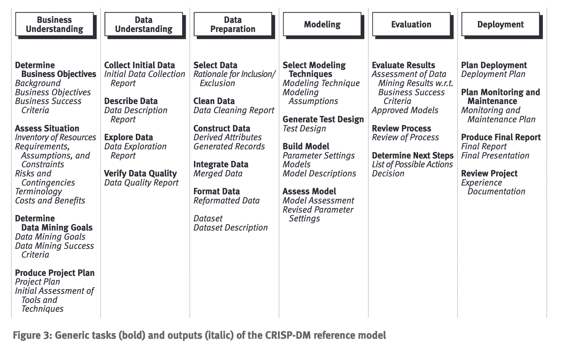

Slide 8
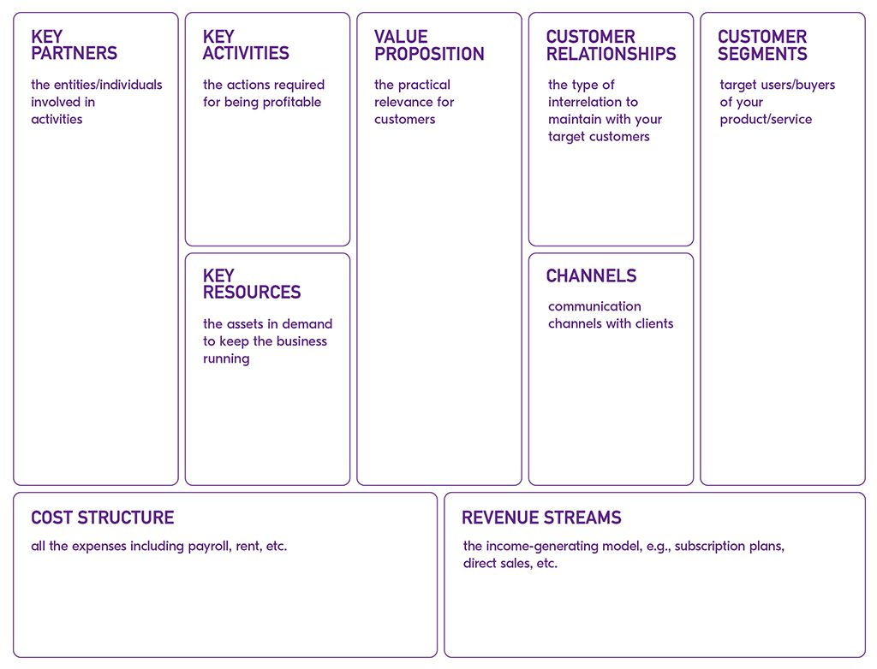
Lean Canvas

Slide 9
Judging Criteria
Business Understanding (5%)
Lean Canvas Role/Persona Definition & Interaction Recommended Enhancements
Data Understanding (10%)
Data Dictionary: meaning/influence on product Data Quality Checks: outliers, missing data, etc…
Data Polarity: relationships among fields
Data Preparation (15%)
Data Formatting
Derived Data
Modelling (25%)
Feature Engineering & Rationale
Model Selections & Finale Rationale
Evaluation (25%)
Accuracy of Model
Model Explain-ability
Business Conclusions
Deployment (20%)
Submission of files
Use of Design Thinking(bonus)
Presentation You are expected to present the work done using the single page poster mentioned

Slide 10
Resources
JupyterHub Tutorial: https://www.dataquest.io/blog/jupyter-notebook-tutorial/ https://www.anaconda.com/products/individual
Google Collab https://www.tutorialspoint.com/google_colab/index.htm
GitHub https://docs.github.com/en/github/creating-cloning-and-archiving-repositories/cloning-a-repository
CRISP-DM Specification https://the-modeling-agency.com/crisp-dm.pdf

Slide 11
Demo

